Slide 1
**Project Overview:**
Our project is an exploration into various facets of technology and tools, aiming to leverage their advantages while navigating the encountered challenges. This venture comprises a diverse set of components, each meticulously chosen to contribute to our project's success.

Slide 2
**Advantages and Challenges:**
Throughout the project, we've uncovered numerous advantages in the technologies and tools we employed, enhancing our efficiency and productivity. Simultaneously, we've encountered challenges that have tested our problem-solving abilities, fostering growth and learning within our team.

Slide 3
Technology and Tool Stack:
To realize our project's goals, we've assembled a comprehensive technology and tool stack. This stack encompasses a range of software and hardware components, each serving a distinct purpose in our project's ecosystem

Slide 4
Introduction/ Overview
Requirements
MileStone
To make it work 100%
To interconnect all in one big project
Kafka
Spark Streaming
SparkSQL
Hive
Tableau Visualization
Achievements
Difficulties
We achieved 95% of our milestone.
Dependencies and and versioning problems in programming parts
Accessing API(E.g. twitter)
Downloading and setting up the visualization part.

Slide 5
Tools / Technologies
Tools
Technologies
IntelliJ
Apache Hive
SparkSQL
Tableau Visualization
Cloudera Hadoop Driver
Java SE 8
Apache Hadoop
Apache Kafka
Spark Streaming

Slide 6
Java SE 8
Java 8 is a version of the Java programming language and platform, which was released by Oracle Corporation in 2014. It is sometimes referred to as "Java SE 8", where "SE" stands for "Standard Edition".
Java 8 introduced several new features and enhancements, including lambda expressions, functional interfaces, method references, and the Stream API, which have made it a popular choice for developing a wide range of software applications.

Slide 7
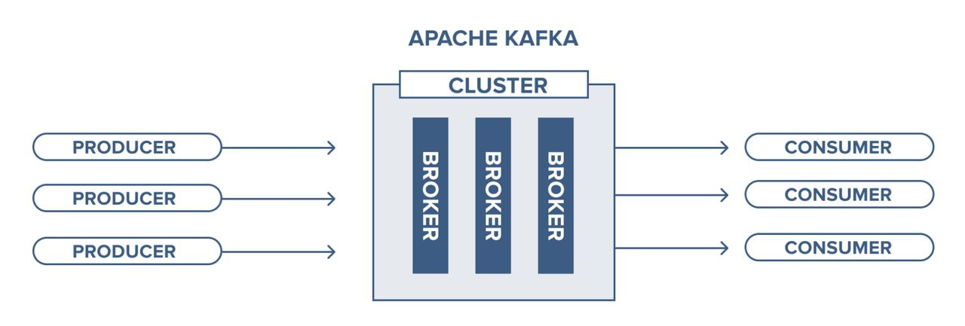
Apache Kafka
Apache Kafka is a distributed streaming platform for real-time data pipelines and applications. It handles high-volume data streams like website logs, app metrics, and IoT sensor data in real-time. Developers use client libraries and tools like Kafka Connect, Kafka Streams, and the Kafka CLI to interact with Kafka clusters and build applications.

Slide 8
Apache Hadoop
Apache Hadoop is a distributed technology for handling massive data sets. It offers scalability and fault tolerance by using standard hardware. Key components include Hadoop Distributed File System (HDFS) for storage and MapReduce for parallel data processing across a cluster. The Hadoop ecosystem, including Apache Hive, Pig, and Spark, extends its capabilities for data manipulation and analysis.

Slide 9
Kafka Commands
Download Kafka from https://archive.apache.org/dist/kafka/
Extract at any location i.e. /home/cloudera/Desktop/kafka_2.11-1.1.0
Run Zookeeper using command “bin/zookeeper-server start.sh config/zookeeper.properties”
Run Kafka Server using command “bin/kafka-server-start.sh config/server.properties”
-Create Topic using command “./bin/kafka-topics.sh --create --bootstrap-server localhost:9092 --replication-factor 1 --partitions 1 --topic song-topic”

Slide 10
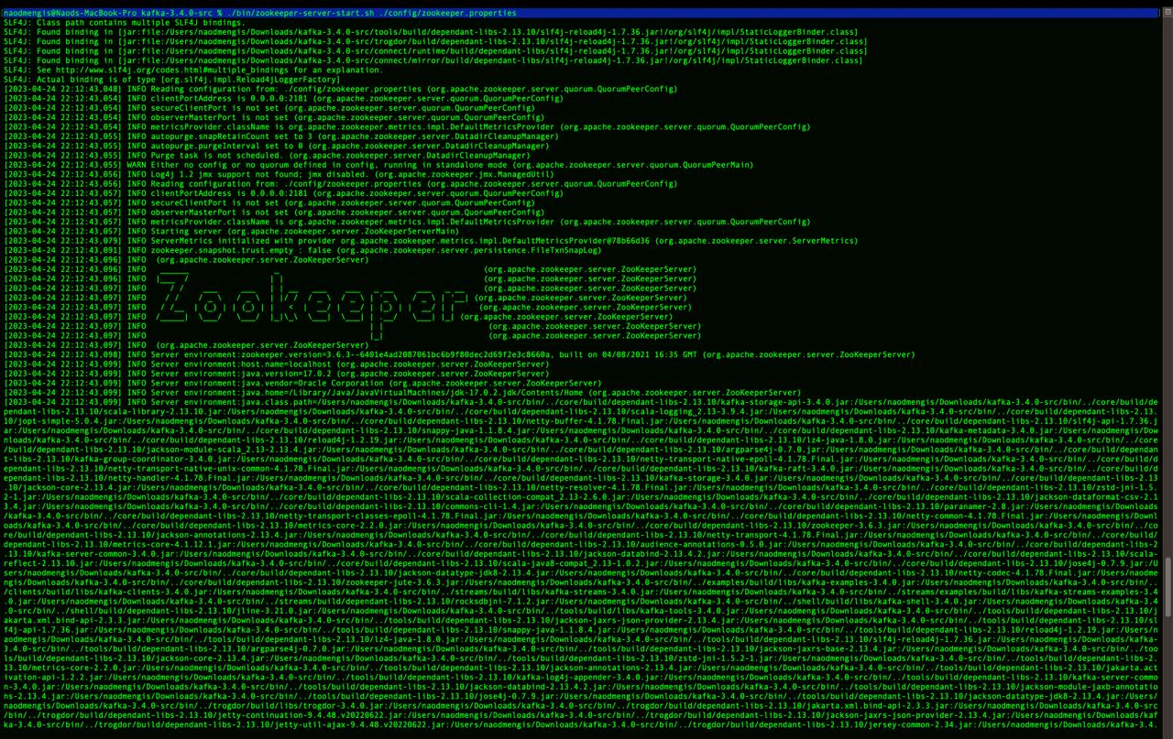
Zoo keeper Terminal

Slide 11
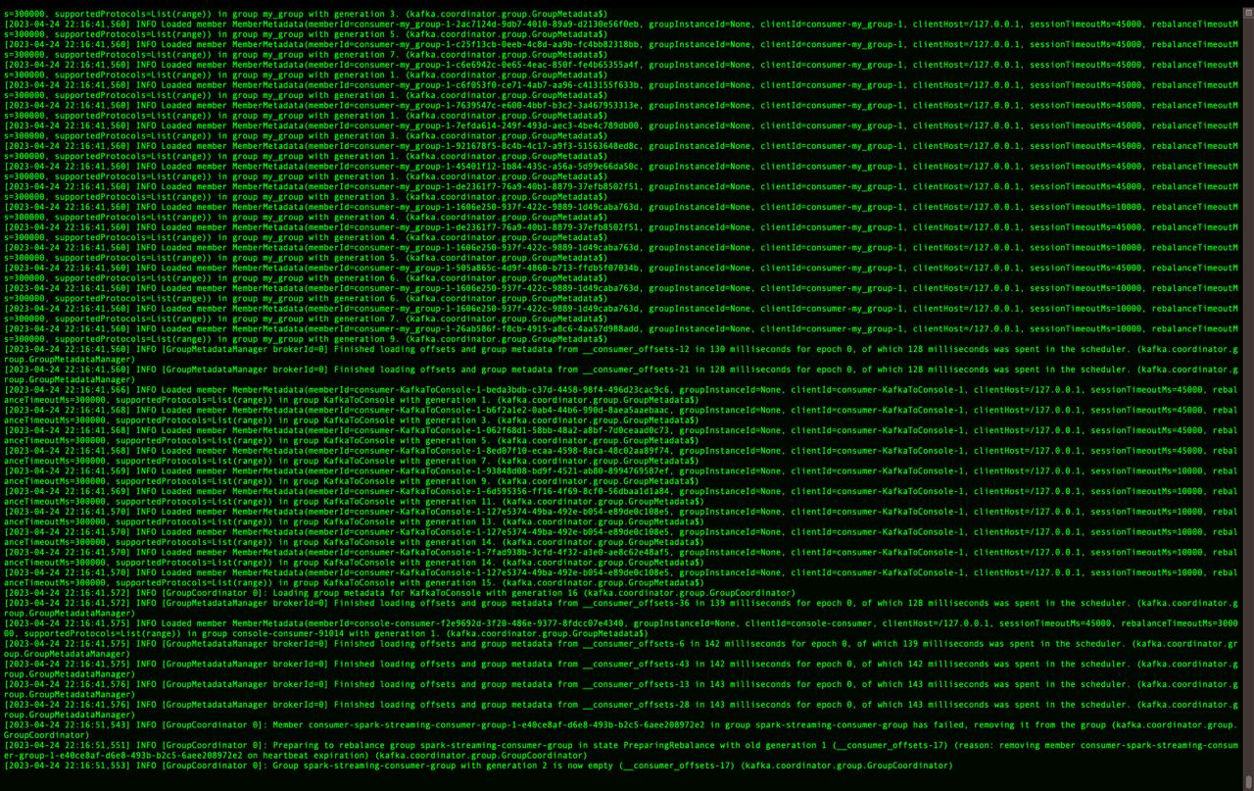
Kafka Terminal

Slide 12
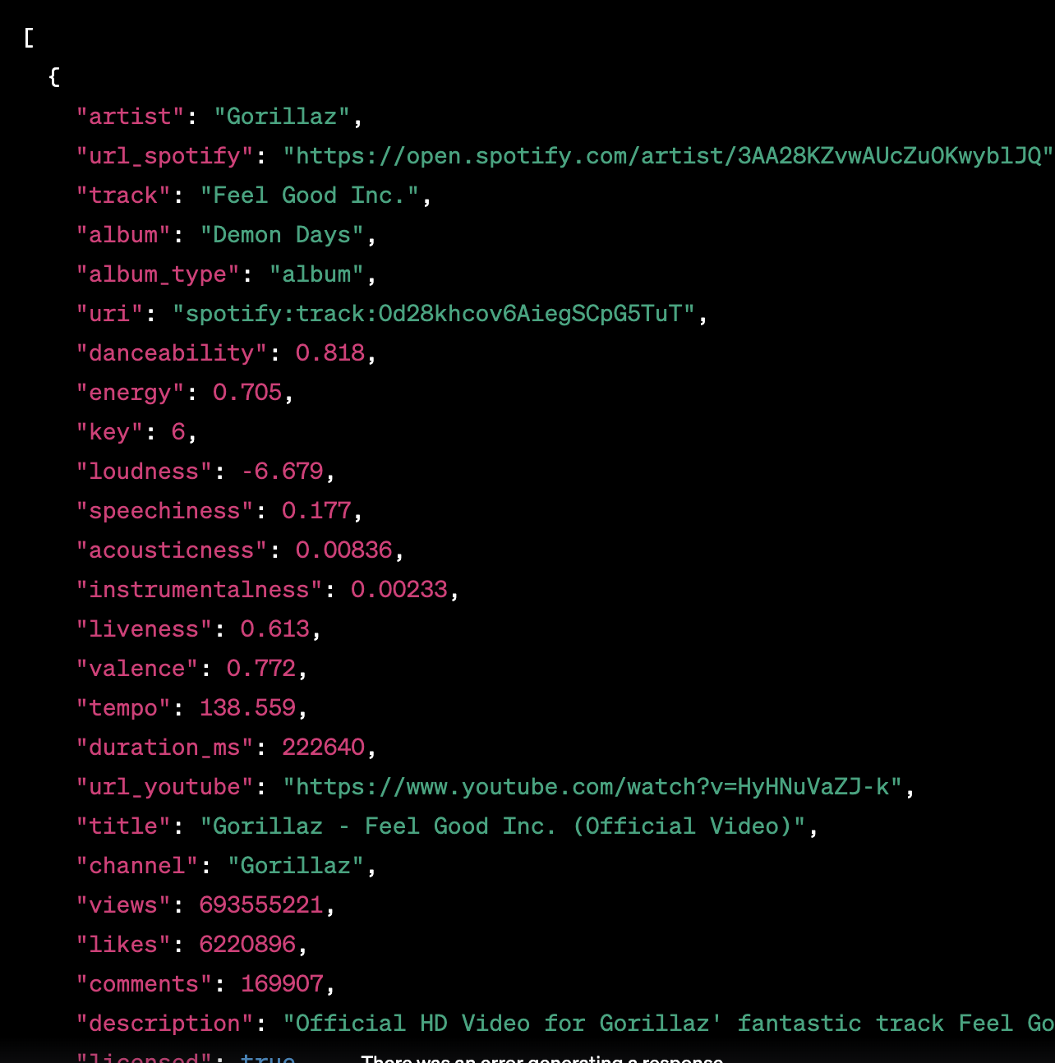
Json format
Of csv file

Slide 13
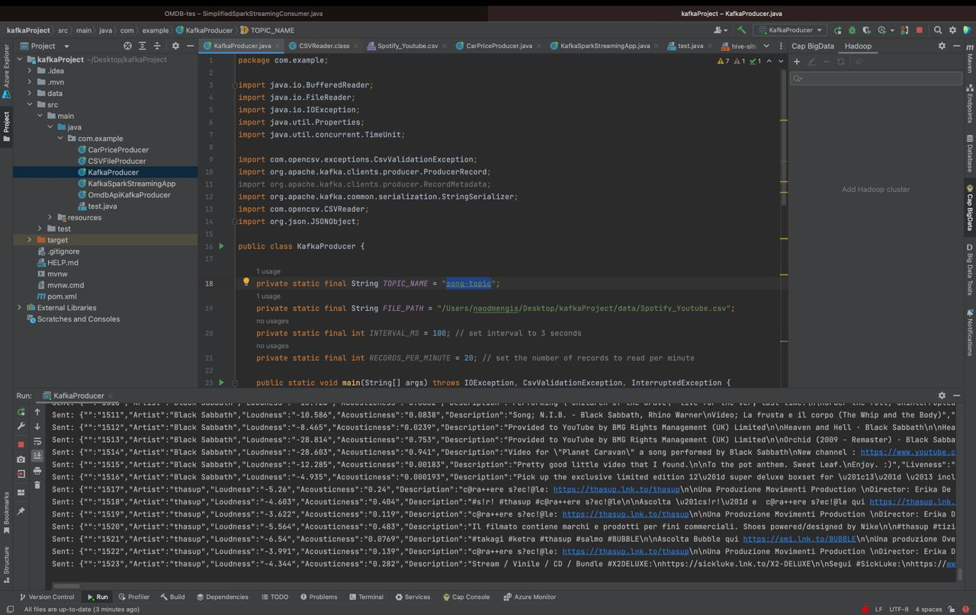
KafkaProducer.java

Slide 14
Spark Streaming
Spark Streaming, built on Apache Spark, offers scalable, high-throughput, and fault-tolerant stream processing for real-time data. It uses the same programming model as batch processing in Spark, supporting data sources like Kafka, Flume, and HDFS, with features like windowed operations and fault tolerance. It's a potent foundation for real-time data stream tools and applications..

Slide 15
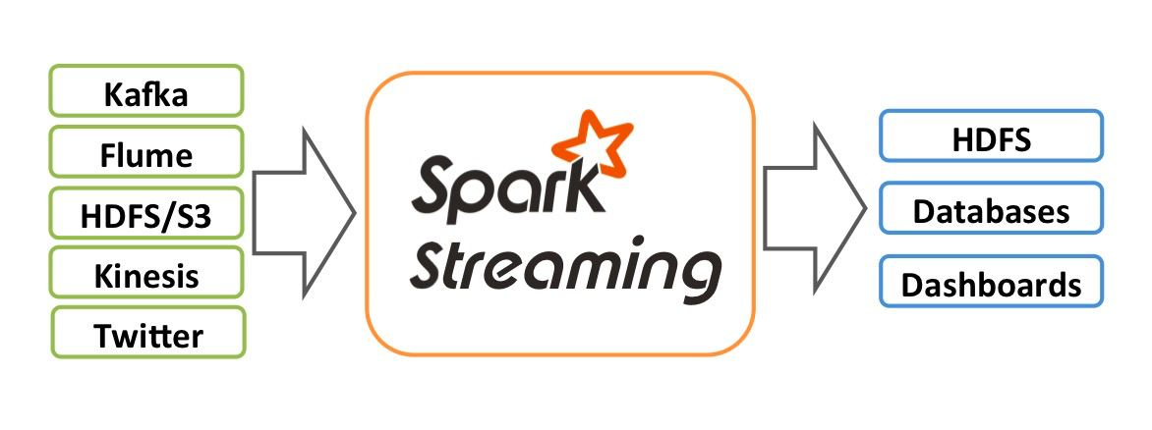
Architecture Stream high-level overview of the architecture implemented. We have data streaming in from Kafka, which is consumed by Spark Streaming. Spark Streaming processes the data in real-time, and the results are stored in Hive for later analysis.

Slide 16
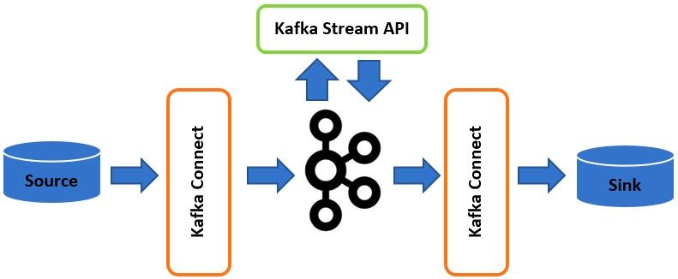
We connected Spark Streaming to a Kafka topic. Spark Streaming then consumes the data from the topic using the Kafka direct stream approach.

Slide 17
We connected Spark Streaming to Hive using a SparkSession object to enable support for the Hive data warehouse.
+-----------------------------------------------+
| Spark Streaming |
| (Direct Stream from Kafka) |
+-----------------------------------------------+
|
|
v
+----------------------------------------------+
| SparkSession |
| (Configured with Hive Metastore) |
+----------------------------------------------+
|
|
v
+------------------------------------------------+
| Hive Metastore |
| (Manages Metadata about Tables) |
+------------------------------------------------+
|
|
v
+-------------------------------------------------+
| Hive Data Warehouse |
| (Stores Hive Table Data) |
+-------------------------------------------------+

Slide 18
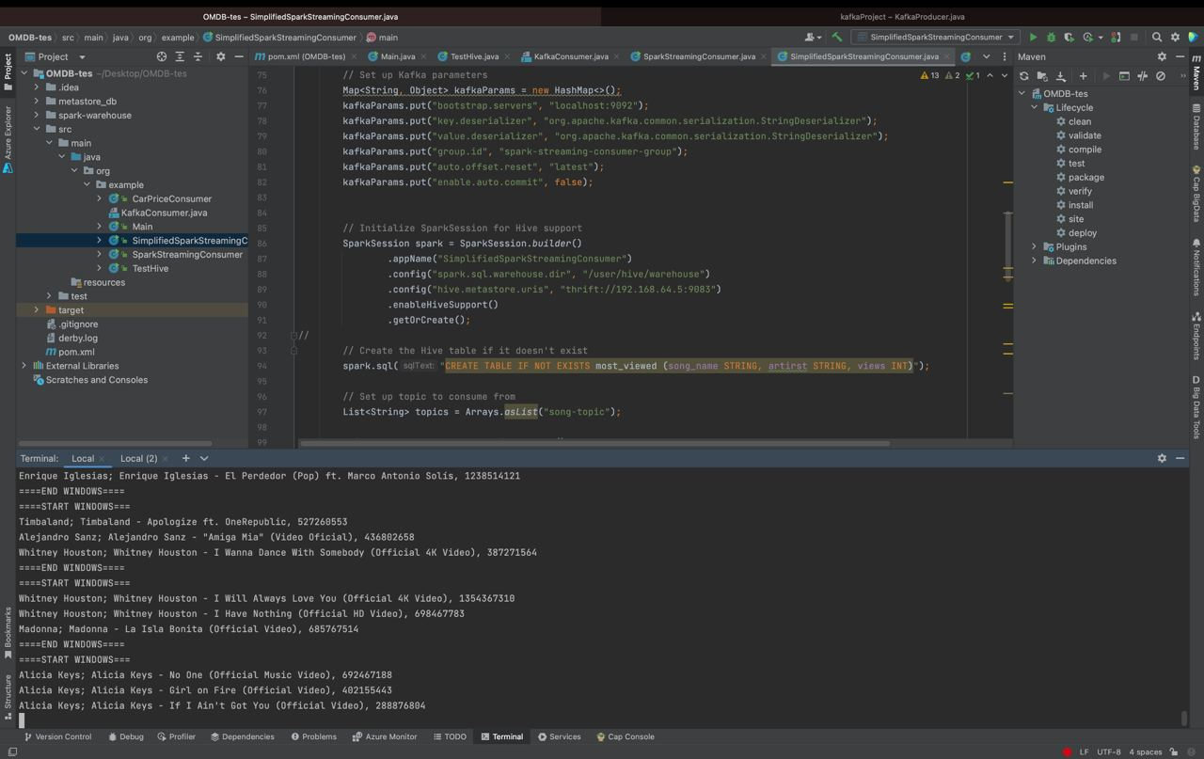
SparkStreamingConusmer.java

Slide 19
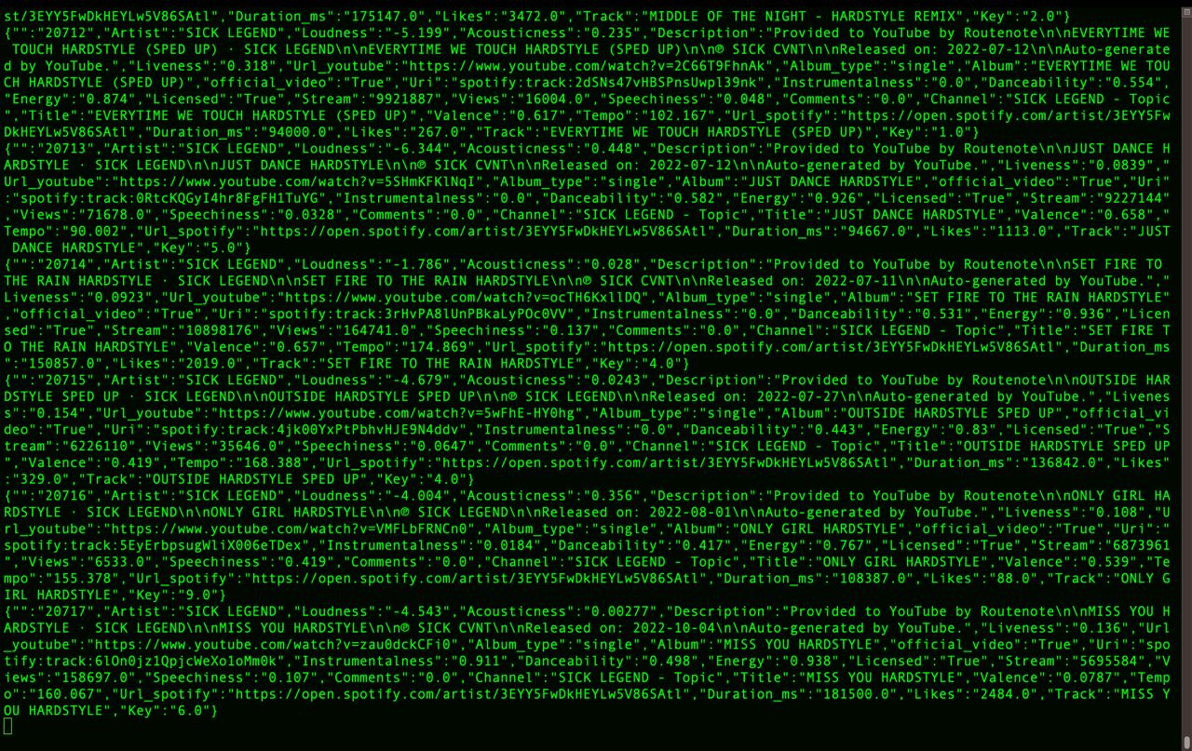
Topic Terminal

Slide 20
Spark SQL
Spark SQL is a module in Apache Spark that enables SQL-based structured data processing, functioning as a distributed SQL query engine. It seamlessly combines relational and procedural processing through declarative DataFrames, optimizing performance for broader user accessibility. Key concepts include the Language API, DataFrame API, and DataSource API. Its advantages include integration, compatibility, standard connectivity, uniform data access, and superior performance and scalability.
-

Slide 21
Apache Hive
Apache Hive is a tool that provides a data warehousing and SQL-like query language for Hadoop,
Efficient storage and process large data
Works with Hadoop
Hive limitation
- launch MapReduce Job
- Lag Performance
- no resume capability
hard drop encrypted database

Slide 22
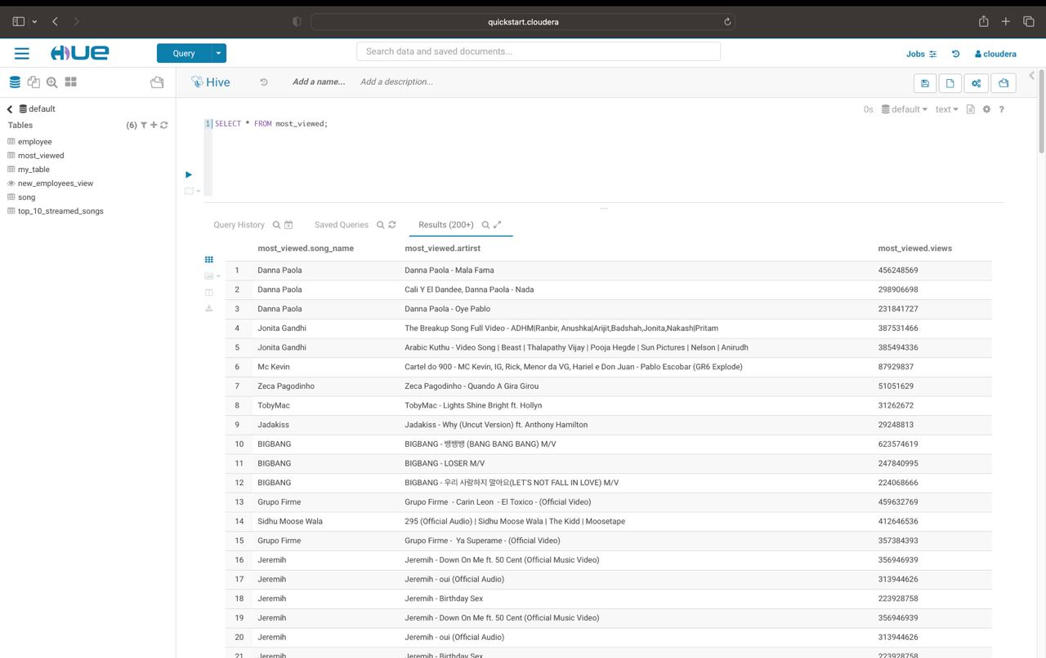
Hive

Slide 23
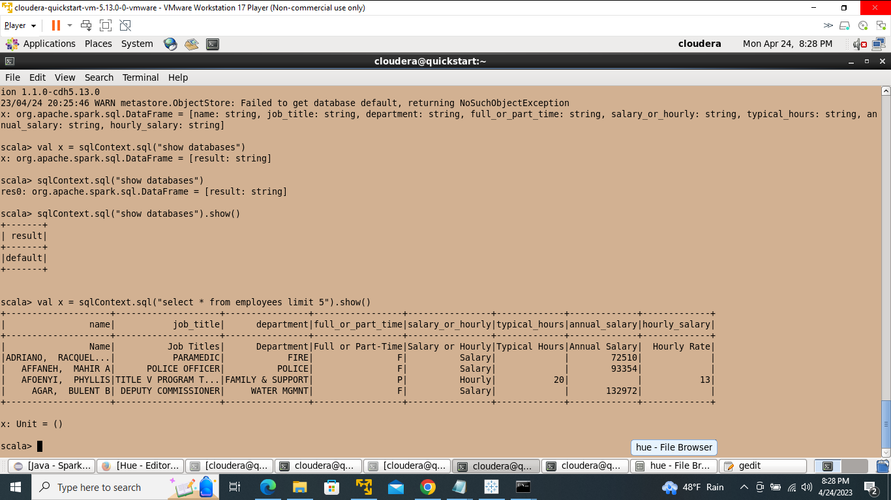
SparkSQL Terminal

Slide 24



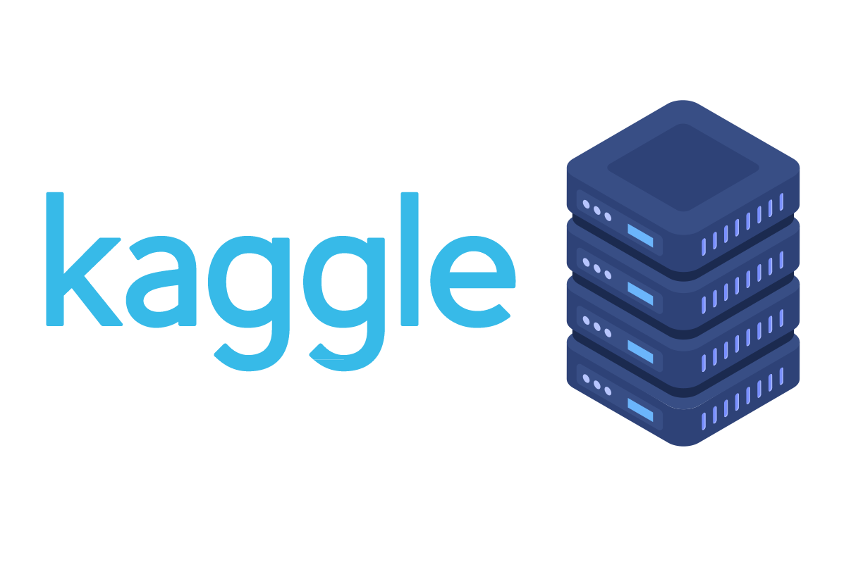



Our Data Streaming pipeline
Data to be streamed

Slide 25
Cloudera Hadoop Driver
The Cloudera Hadoop driver serves as a vital link connecting the Cloudera Hadoop platform with various external software applications, like Tableau. This facilitates seamless data transfer and processing between them. Essentially, it acts as a software component that enables these applications to interact with Cloudera Hadoop and access data stored in the Hadoop Distributed File System (HDFS).
Key features of the Cloudera Hadoop driver include support for popular programming languages like Java, Python, and Scala, along with integration capabilities with other tools and frameworks such as Apache Spark, Apache Hive, and Apache Pig. In essence, while Cloudera Hadoop provides the distributed storage and processing framework for large-scale data sets, the Cloudera Hadoop driver acts as the bridge that connects Cloudera Hadoop with various external software applications.

Slide 26
Cloudera Hadoop Driver Download Steps
We used this link to download Cloudera Hadoop Driver: https://www.cloudera.com/downloads.html
We scrolled down and selected Hive ODBC Driver downloads: https://www.cloudera.com/downloads/connectors/hive/odbc/2-6-16.html
We would be required to complete our operator info, and after we did so, we successfully downloaded Cloudera Hadoop Driver.

Slide 27
Tableau Visualization
Tableau is a robust data visualization and business intelligence platform, ideal for analyzing and visualizing extensive data sets. Users can connect to diverse data sources, like spreadsheets, databases, and cloud services, to craft interactive visualizations, dashboards, and reports. In essence, Tableau empowers users to interact effectively with their data. Furthermore, we seamlessly integrated Tableau with our Cloudera Hadoop data using the Cloudera Hadoop Driver.

Slide 28
Tableau Visualization Download Steps
We used this link to download Tableau: https://public.tableau.com/en-us/s/download
We Selected Try now on the right top corner: https://www.tableau.com/products/trial
We scrolled down and selected Tableau Desktop Download a free trial : https://www.tableau.com/products/desktop/download
We would be required to complete the form, and after we did so, we successfully downloaded Tableau.

Slide 29
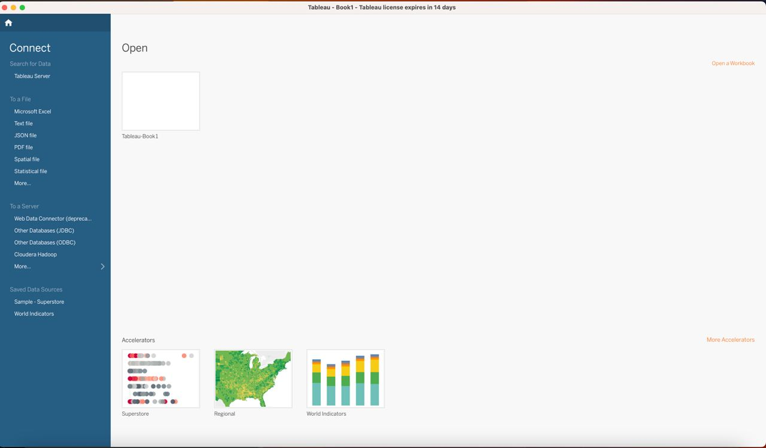
Tableau Desktop

Slide 30


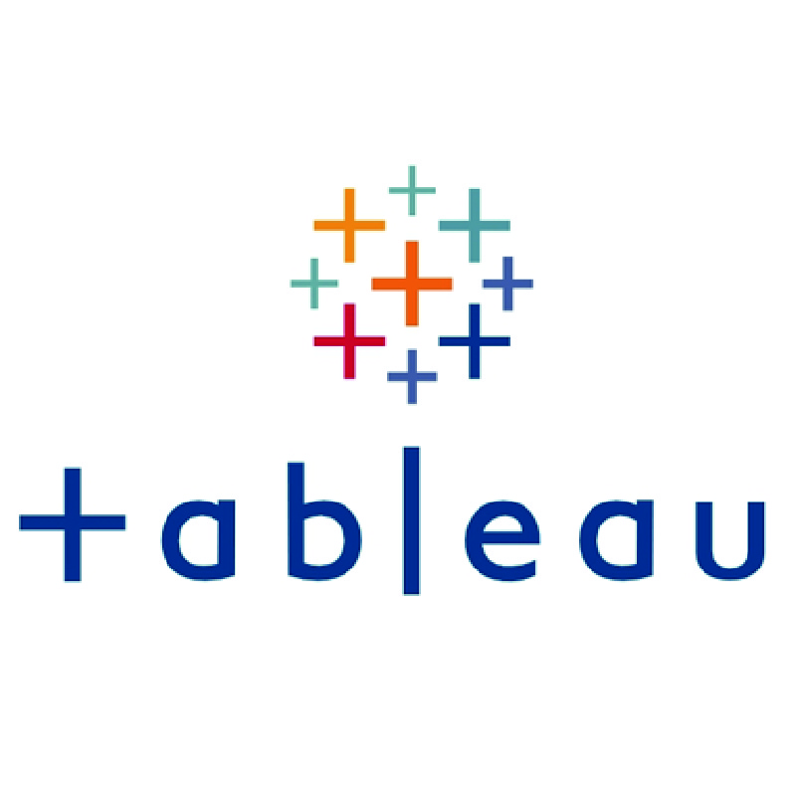
Our Data Tableau Visualization pipeline
Data to be streamed
Employee dataset

Slide 31
THANK You For Listening!

